Slide 1

Topic Modeling

Slide 2
Natural Language Processing Bootcamp
Section Goals
Understand Topic Modeling
Learn Latent Dirichlet Allocation
Implement LDA
Understand Non-Negative Matrix Factorization
Implement NMF
Apply LDA and NMF with a project

Slide 3
Topic Modeling Overview

Slide 4
Natural Language Processing Bootcamp
Before we learn about methods such as Latent Dirichlet Allocation or Non-negative Matrix Factorization, let’s understand the general concept of Topic Modeling and why it’s important!

Slide 5
Natural Language Processing Bootcamp
Topic Modeling allows for us to efficiently analyze large volumes of text by clustering documents into topics.
A large amount of text data is unlabeled meaning we won’t be able to apply our previous supervised learning approaches to create machine learning models for the data!

Slide 6
Natural Language Processing Bootcamp
If we have unlabeled data, then we can attempt to “discover” labels.
In the case of text data, this means attempting to discover clusters of documents, grouped together by topic.

Slide 7
Natural Language Processing Bootcamp
A very important idea to keep in mind here is that we don’t know the “correct” topic or “right answer”!
All we know is that the documents clustered together share similar topic ideas.
It is up to the user to identify what these topics represent.

Slide 8
Natural Language Processing Bootcamp
We will begin by examining how Latent Dirichlet Allocation can attempt to discover topics for a corpus of documents!

Slide 9
Latent Dirichlet Allocation
With Python - Part One

Slide 10
Natural Language Processing Bootcamp
Johann Peter Gustav Lejeune Dirichlet was a German mathmatician in the 1800s who contributed widely to the field of modern mathematics.
There is a probability distribution named after him “Dirichlet Distribution”.

Slide 11
Natural Language Processing Bootcamp
Latent Dirichlet Allocation is based off this probability distribution.
In 2003 LDA was first published as a graphical model for topic discovery in Journal of Machine Learning Research by David Blei, Andrew Ng and Michael I. Jordan.

Slide 12
Natural Language Processing Bootcamp
Let’s get a high level overview of how LDA works for topic modelling.
I encourage you to also take a look at the original publication paper!

Slide 13
Natural Language Processing Bootcamp
Assumptions of LDA for Topic Modeling
Documents with similar topics use similar groups of words
Latent topics can then be found by searching for groups of words that frequently occur together in documents across the corpus.

Slide 14
Natural Language Processing Bootcamp
Assumptions of LDA for Topic Modeling
Documents are probability distributions over latent topics.
Topics themselves are probability distributions over words.

Slide 15
Natural Language Processing Bootcamp
Documents are probability distributions over latent topics.
DOC 1
1
2
3
4
5
Topics

Slide 16
Natural Language Processing Bootcamp
Documents are probability distributions over latent topics.
DOC 2
1
2
3
4
5
Topics

Slide 17
Natural Language Processing Bootcamp
Topics themselves are probability distributions over words.
Topic 1
………..
he
food
read
home
film
cat
dog
Vocabulary of all words in Corpus

Slide 18
Natural Language Processing Bootcamp
LDA represents documents as mixtures of topics that spit out words with certain probabilities.

Slide 19
Natural Language Processing Bootcamp
It assumes that documents are produced in the following fashion:
Decide on the number of words N the document will have.

Slide 20
Natural Language Processing Bootcamp
It assumes that documents are produced in the following fashion:
Choose a topic mixture for the document (according to a Dirichlet distribution over a fixed set of K topics).
e.g. 60% business, 20% politics, 10% food

Slide 21
Natural Language Processing Bootcamp
Generate each word in the document by:
First picking a topic according to the multinomial distribution that you sampled previously (60% business, 20% politics, 10% food)

Slide 22
Natural Language Processing Bootcamp
Generate each word in the document by:
Using the topic to generate the word itself (according to the topic’s multinomial distribution).
For example, if we selected the food topic, we might generate the word “apple” with 60% probability, “home” with 30% probability, and so on.

Slide 23
Natural Language Processing Bootcamp
Assuming this generative model for a collection of documents, LDA then tries to backtrack from the documents to find a set of topics that are likely to have generated the collection.

Slide 24
Natural Language Processing Bootcamp
Now imagine we have a set of documents.
We’ve chosen some fixed number of K topics to discover, and want to use LDA to learn the topic representation of each document and the words associated to each topic.

Slide 25
Natural Language Processing Bootcamp
Go through each document, and randomly assign each word in the document to one of the K topics.
This random assignment already gives you both topic representations of all the documents and word distributions of all the topics (note, these initial random topics won’t make sense).

Slide 26
Natural Language Processing Bootcamp
Now we iterate over every word in every document to improve these topics.
For every word in every document and for each topic t we calculate:
p(topic t | document d) = the proportion of words in document d that are currently assigned to topic t

Slide 27
Natural Language Processing Bootcamp
Now we iterate over every word in every document to improve these topics.
For every word in every document and for each topic t we calculate:
p(word w | topic t) = the proportion of assignments to topic t over all documents that come from this word w

Slide 28
Natural Language Processing Bootcamp
Reassign w a new topic, where we choose topic t with probability p(topic t | document d) * p(word w | topic t)
This is essentially the probability that topic t generated word w

Slide 29
Natural Language Processing Bootcamp
After repeating the previous step a large number of times, we eventually reach a roughly steady state where the assignments are acceptable.

Slide 30
Natural Language Processing Bootcamp
At the end we have each document assigned to a topic.
We also can search for the words that have the highest probability of being assigned to a topic.

Slide 31
Natural Language Processing Bootcamp
We end up with an output such as:
Document assigned to Topic #4
Most common words (highest probability) for Topic #4:
[‘cat’,’vet’,’birds’,’dog’,...,’food’,’home’]
It is up to the user to interpret these topics.

Slide 32
Natural Language Processing Bootcamp
Two important notes:
The user must decide on the amount of topics present in the document.
The user must interpret what the topics are.
Let’s explore how to implement LDA with Python!

Slide 33
Latent Dirichlet Allocation with Python
PART TWO

Slide 34
Non-Negative Matrix Factorization

Slide 35
Natural Language Processing Bootcamp
Non-negative Matrix Factorization is an unsupervised algorithm that simultaneously performs dimensionality reduction and clustering.
We can use it in conjunction with TF-IDF to model topics across documents.

Slide 36
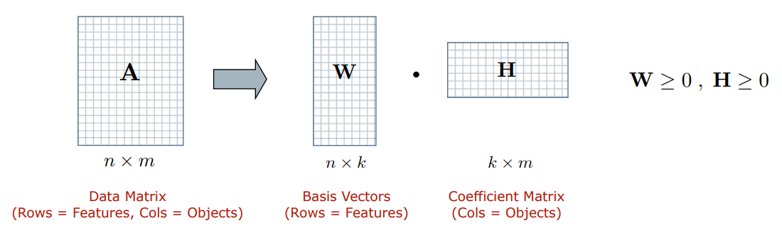
Natural Language Processing Bootcamp
Given a non-negative matrix A, find k-dimension approximation in terms of non-negative factors W and H

Slide 37
Natural Language Processing Bootcamp
Approximate each object (i.e. column of A) by a linear combination of k reduced dimensions or “basis vectors” in W.

Slide 38
Natural Language Processing Bootcamp
Each basis vector can be interpreted as a cluster. The memberships of objects in these clusters encoded by H.

Slide 39
Natural Language Processing Bootcamp
Input: Non-negative data matrix (A), number of basis vectors (k), initial values for factors W and H (e.g. random matrices).

Slide 40
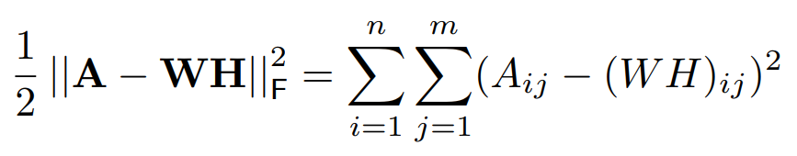
Natural Language Processing Bootcamp
Objective Function: Some measure of reconstruction error between A and the approximation WH

Slide 41
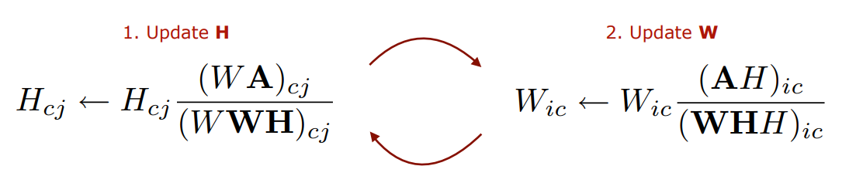
Natural Language Processing Bootcamp
Expectation–maximization optimisation to refine W and H in order to minimise the objective function. Common approach is to iterate between two multiplicative update rules until convergence

Slide 42
Natural Language Processing Bootcamp
Construct vector space model for documents (after stopword filtering), resulting in a term-document matrix A.
Apply TF-IDF term weight normalisation to A
Normalize TF-IDF vectors to unit length.
Initialise factors using NNDSVD on A.
Apply Projected Gradient NMF to A.

Slide 43
Natural Language Processing Bootcamp
Basis vectors: the topics (clusters) in the data.
Coefficient matrix: the membership weights for documents relative to each topic (cluster).

Slide 44
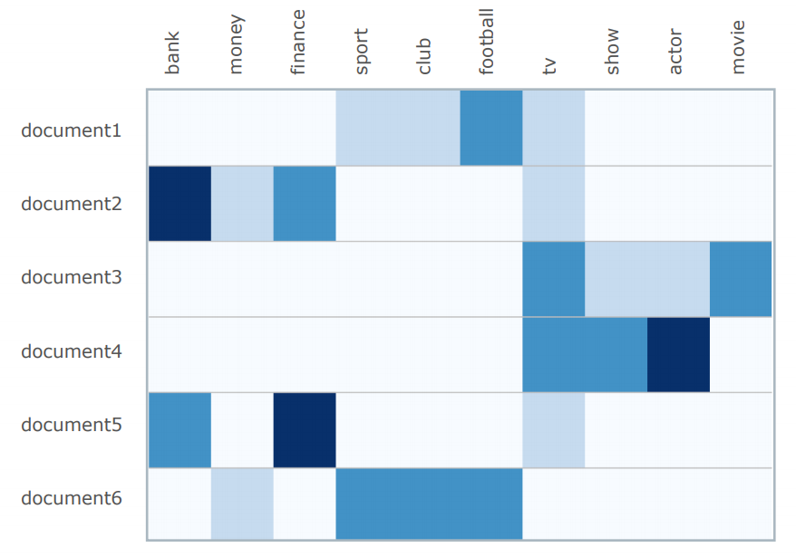
Natural Language Processing Bootcamp
Create a document term matrix with TF-IDF Vectorization.

Slide 45
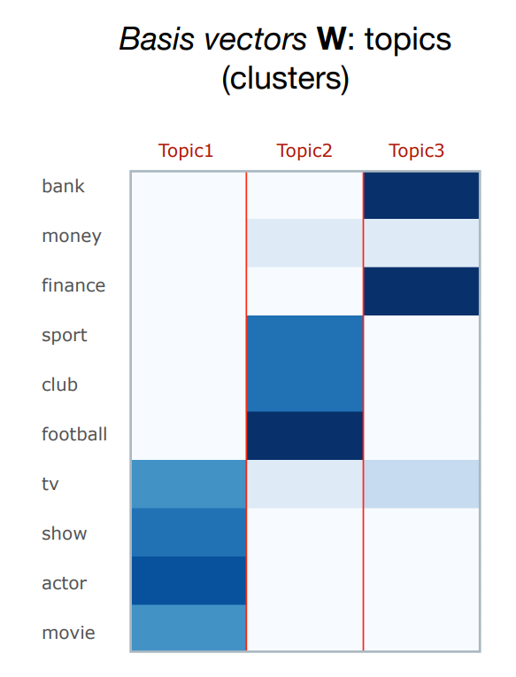
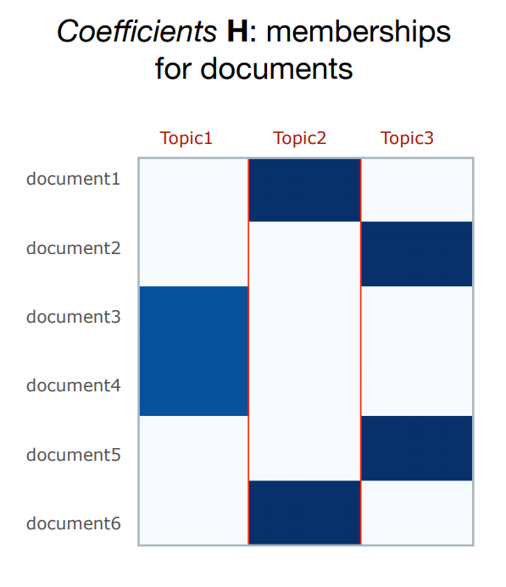
Natural Language Processing Bootcamp
Resulting W and H

Slide 46
Natural Language Processing Bootcamp
Just like LDA, we will need to select the number of expected topics beforehand (the value of k)!
Also just like with LDA, we will have to interpret the topics based off the coefficient values of the words per topic.

Slide 47
Natural Language Processing Bootcamp
Luckily, due to Scikit-Learn’s uniform syntax, switching out LDA for NMF is very simple.
Let’s repeat our analysis of the NPR Article data set and discover topics with NMF.

Slide 48
Non-Negative Matrix Factorization
with Python

Slide 49
Topic Modeling
Assessment Solutions

